Slide 1
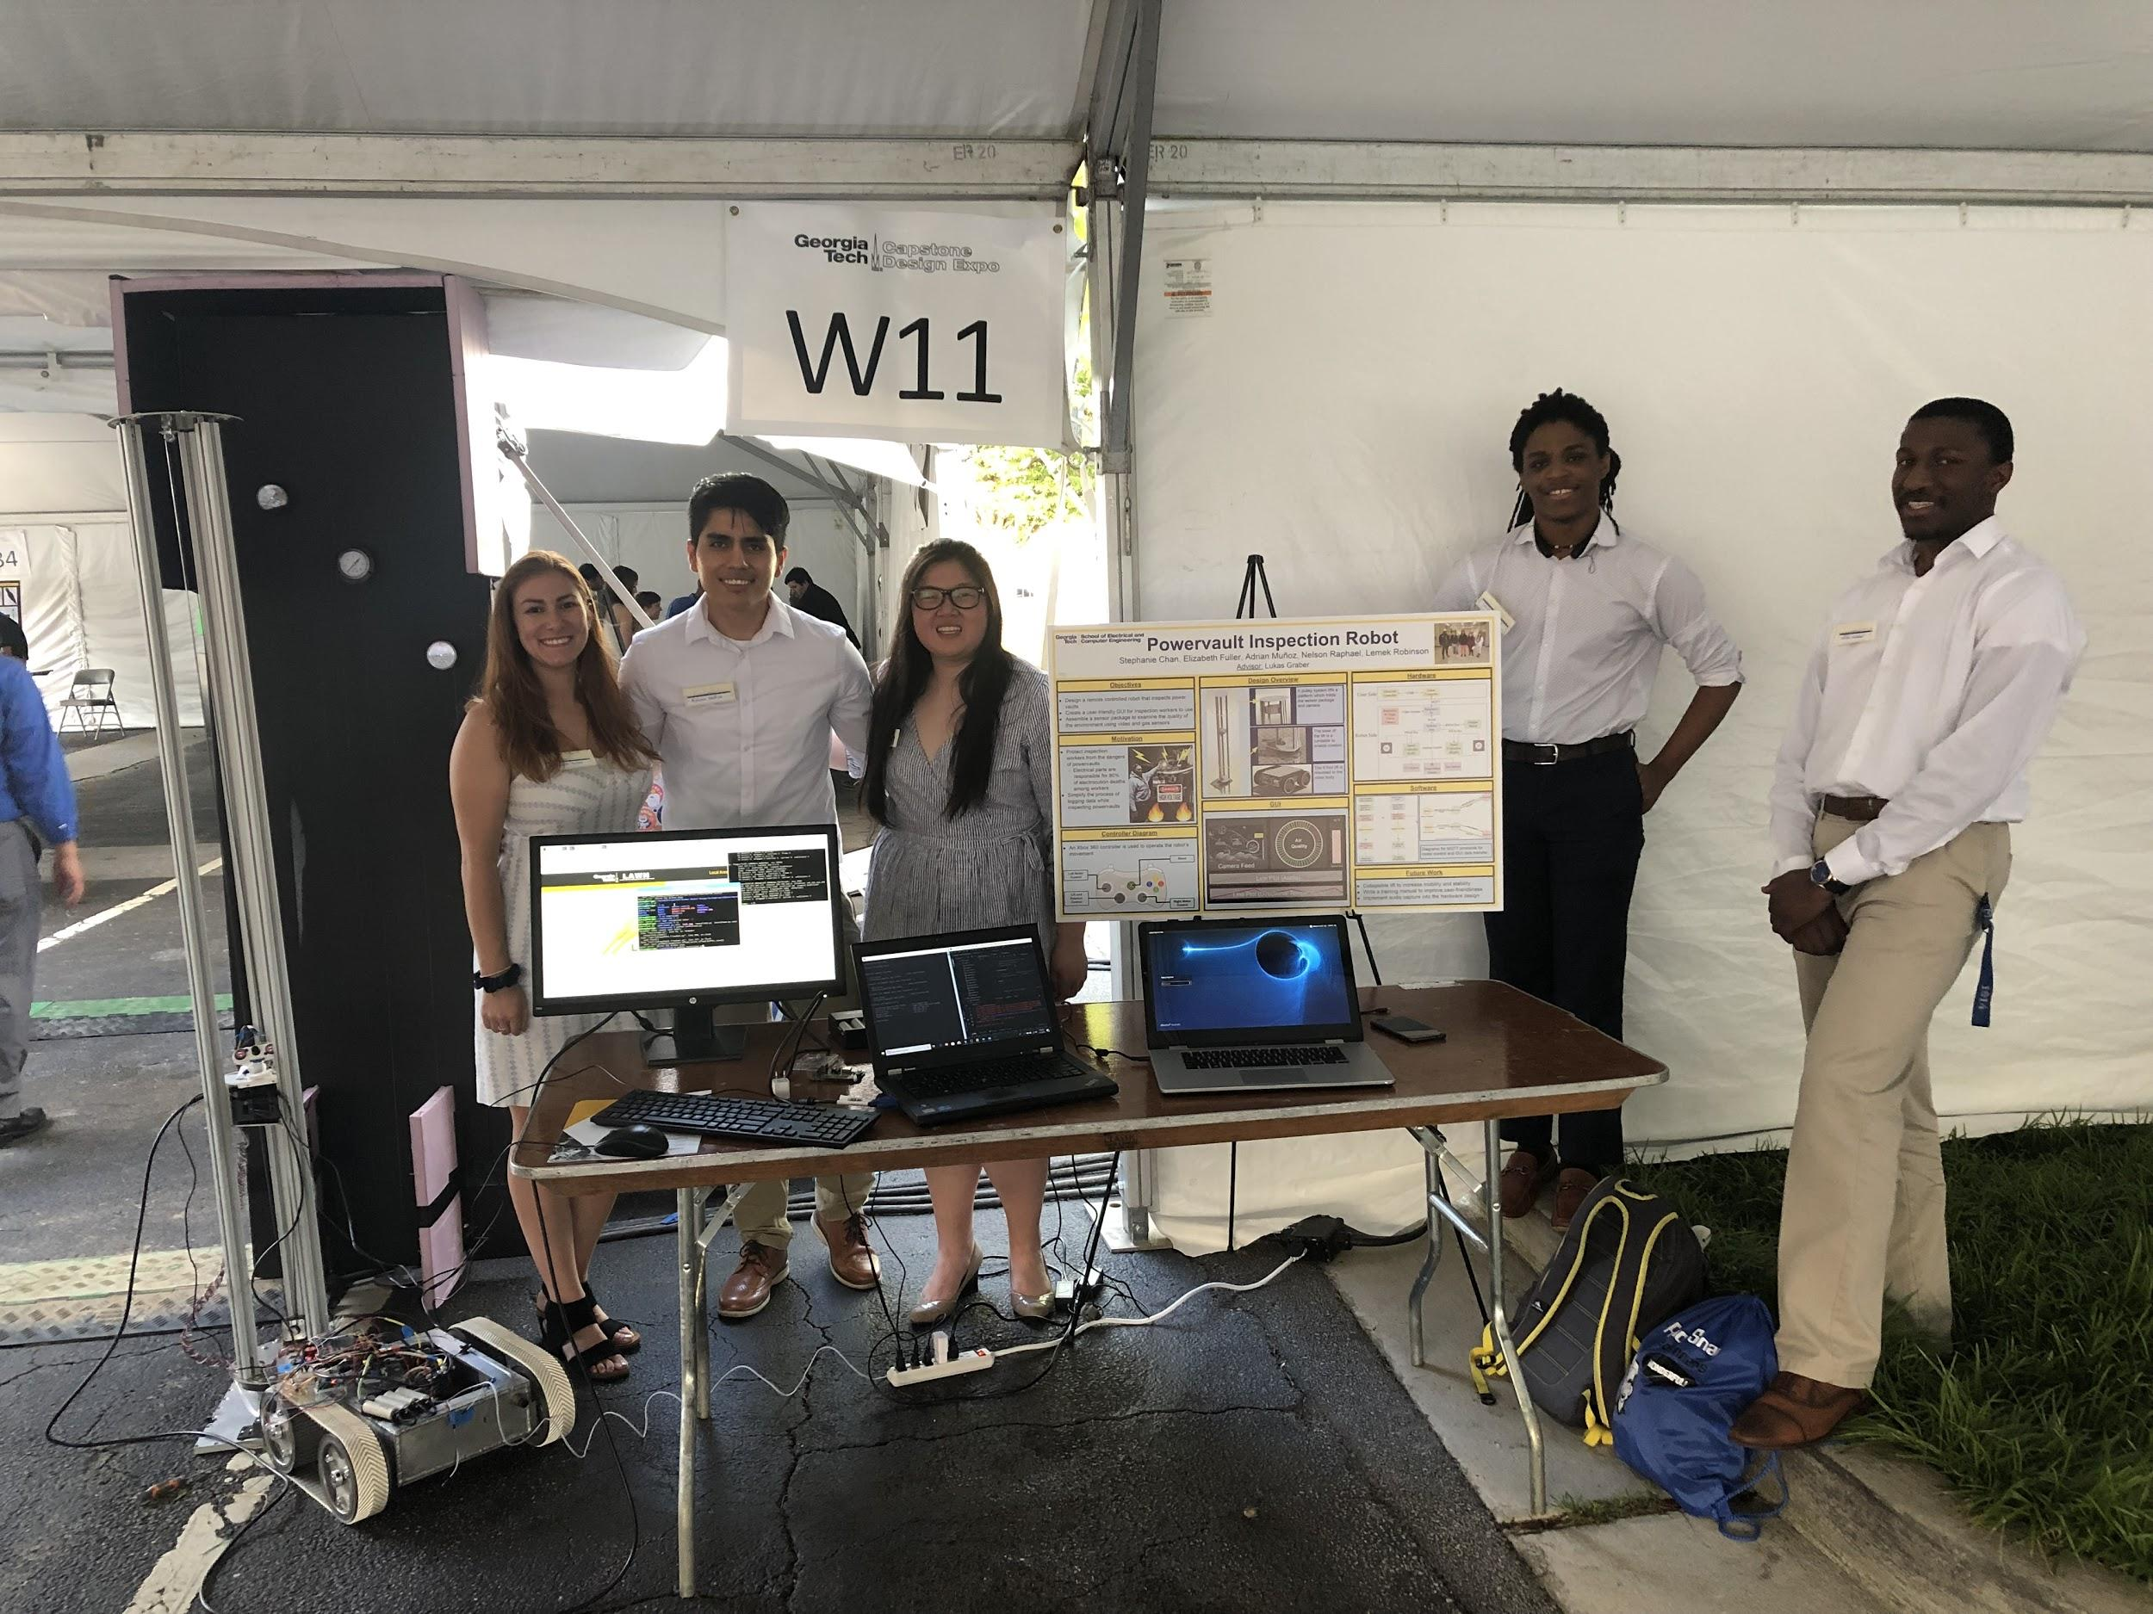
P.V.I.R Final Presentation
4/24/2019
Project Advisor: Lukas Graber
Stephanie Chan, stephchan40@gatech.edu
Elizabeth Fuller, efuller3@gatech.edu
Adrian Muñoz, am262601@gatech.edu
Nelson Raphael, nraphael7@gatech.edu
Lemek Robinson, lrobinson61@gatech.edu

Slide 2
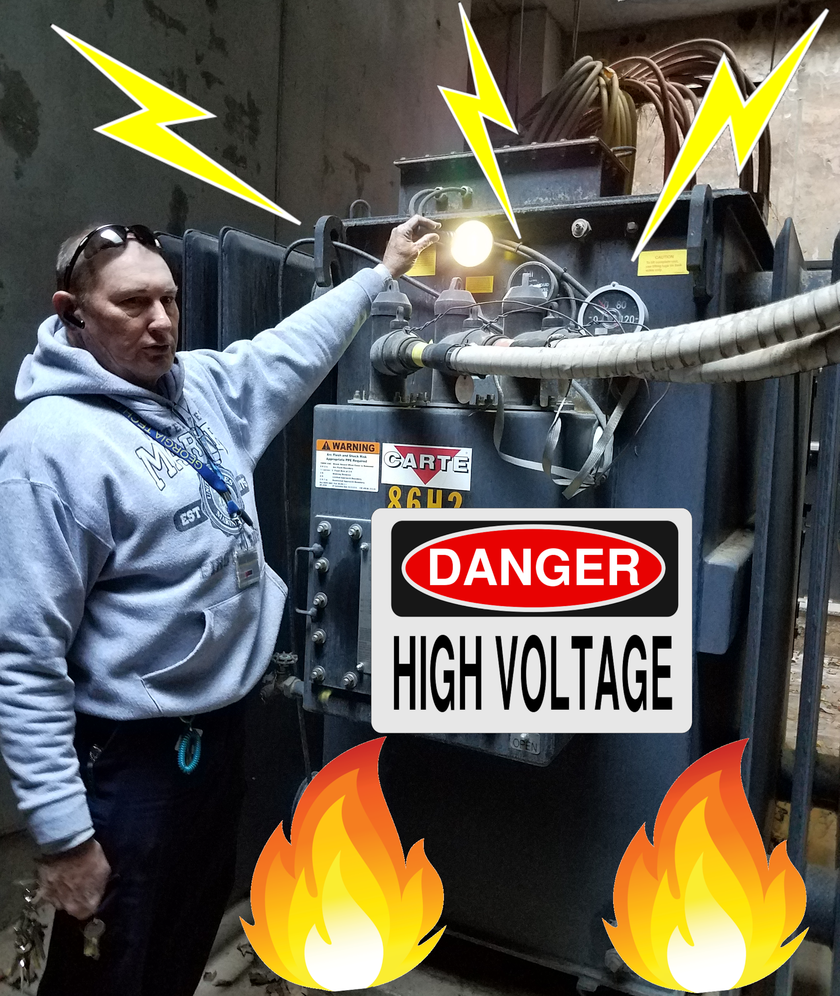
Motivation
Protect inspection workers from the dangers of powervaults
Electrical parts are responsible for 80% of electrocution deaths among workers [1]
Simplify the process of logging data and inspecting powervaults

Slide 3
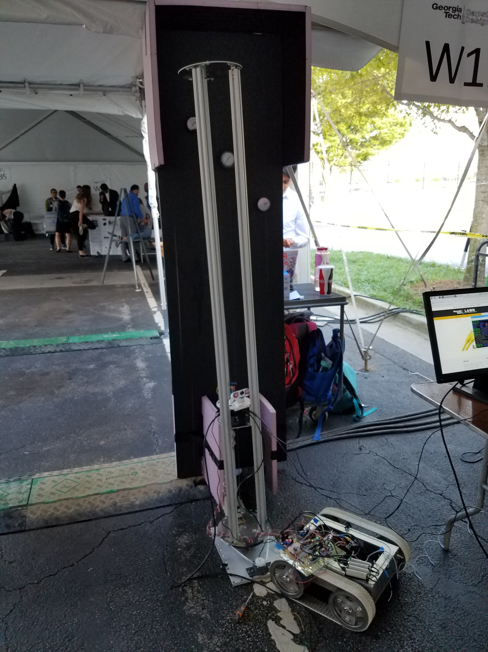
Objectives
Design, program, and build a remote controlled Power Vault Inspection Robot
Create a user-friendly GUI
Assemble a sensor package to examine the quality of the environment using video and gas sensors
Design and build a mechanical lift
Design and build a test environment to demonstrate the robot at the Capstone Design Expo

Slide 4
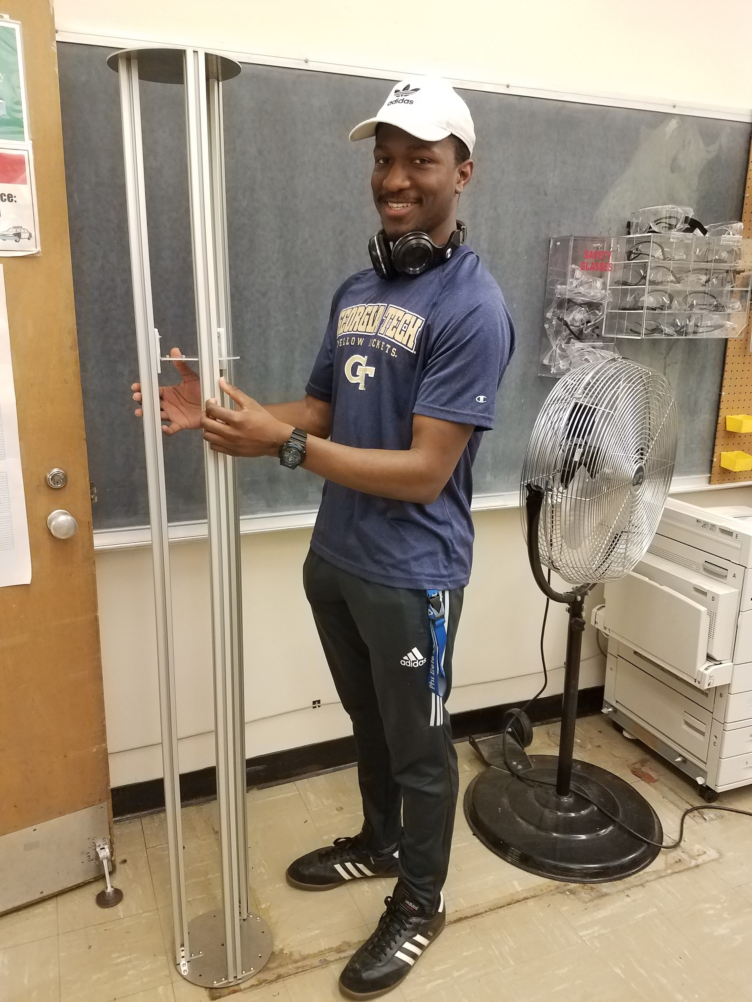
Specifications
Mechanical Arm Specs
Height : Variable height from 1 - 6 feet ✔
Degrees of Freedom : 2 degrees of movement ✔
Base Size : Fits in a 760mm Diameter Manhole✔
Sensor Package Specs
Video : Can Stream Video to GUI ✔
Gas Sensor : Check Air Quality ✔
IR Thermal Camera : Record Thermal Images ✔
Microphone : Record Sounds
GUI Specs
Mobile: Usable on Mobile Platforms ✔
Control Capabilities: Remotely Controllable Robot ✔
Logging: Log Information ✔
Data Streaming: Real-Time Data Streaming ✔

Slide 5
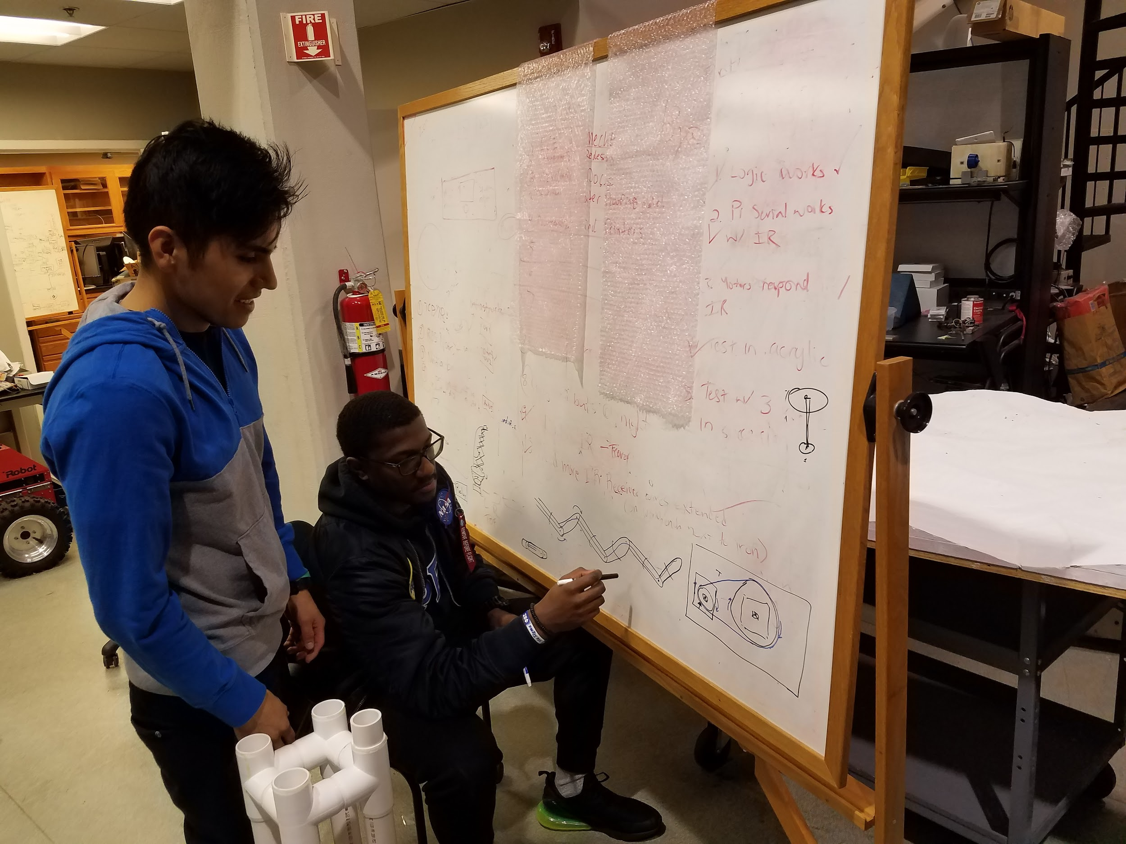
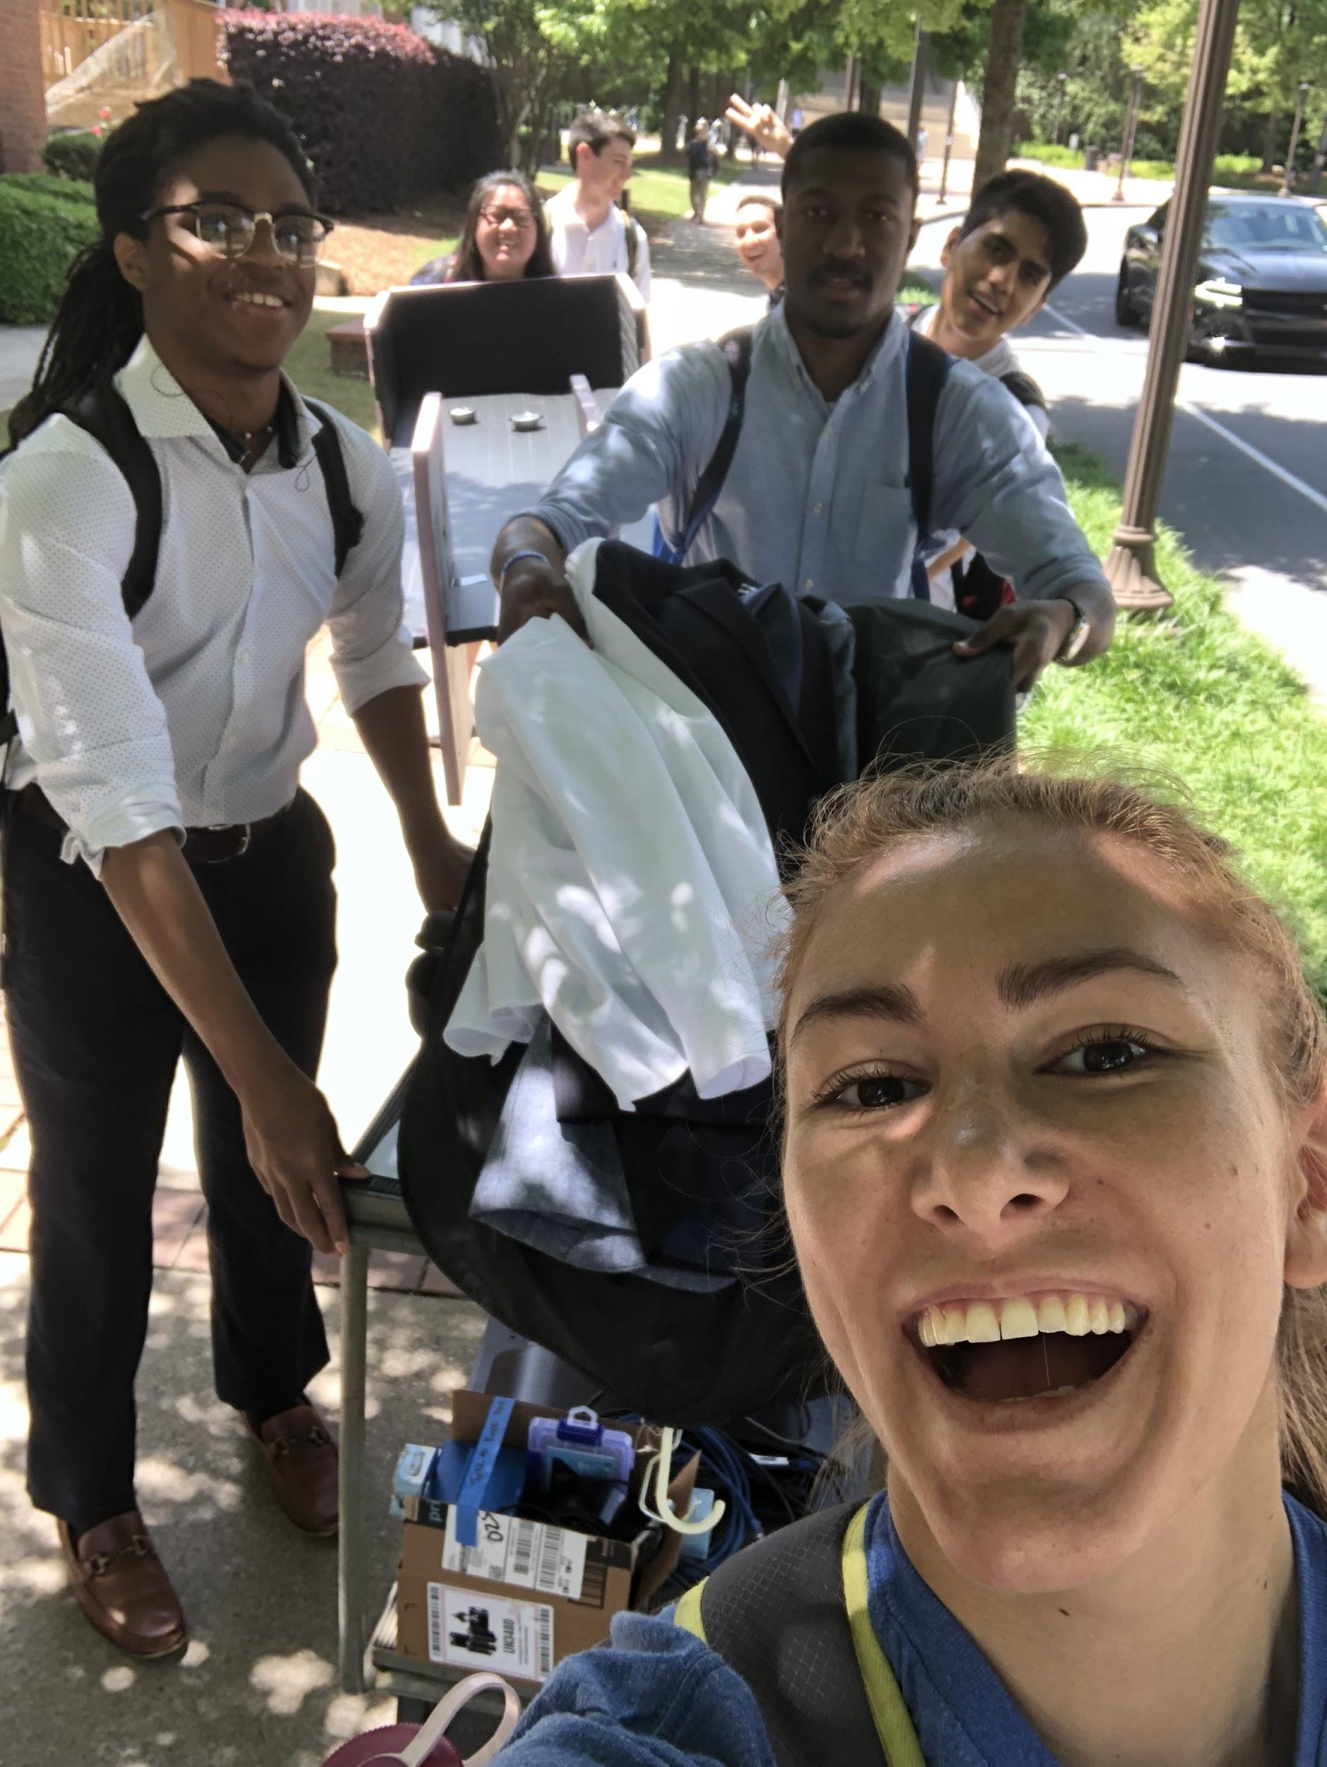
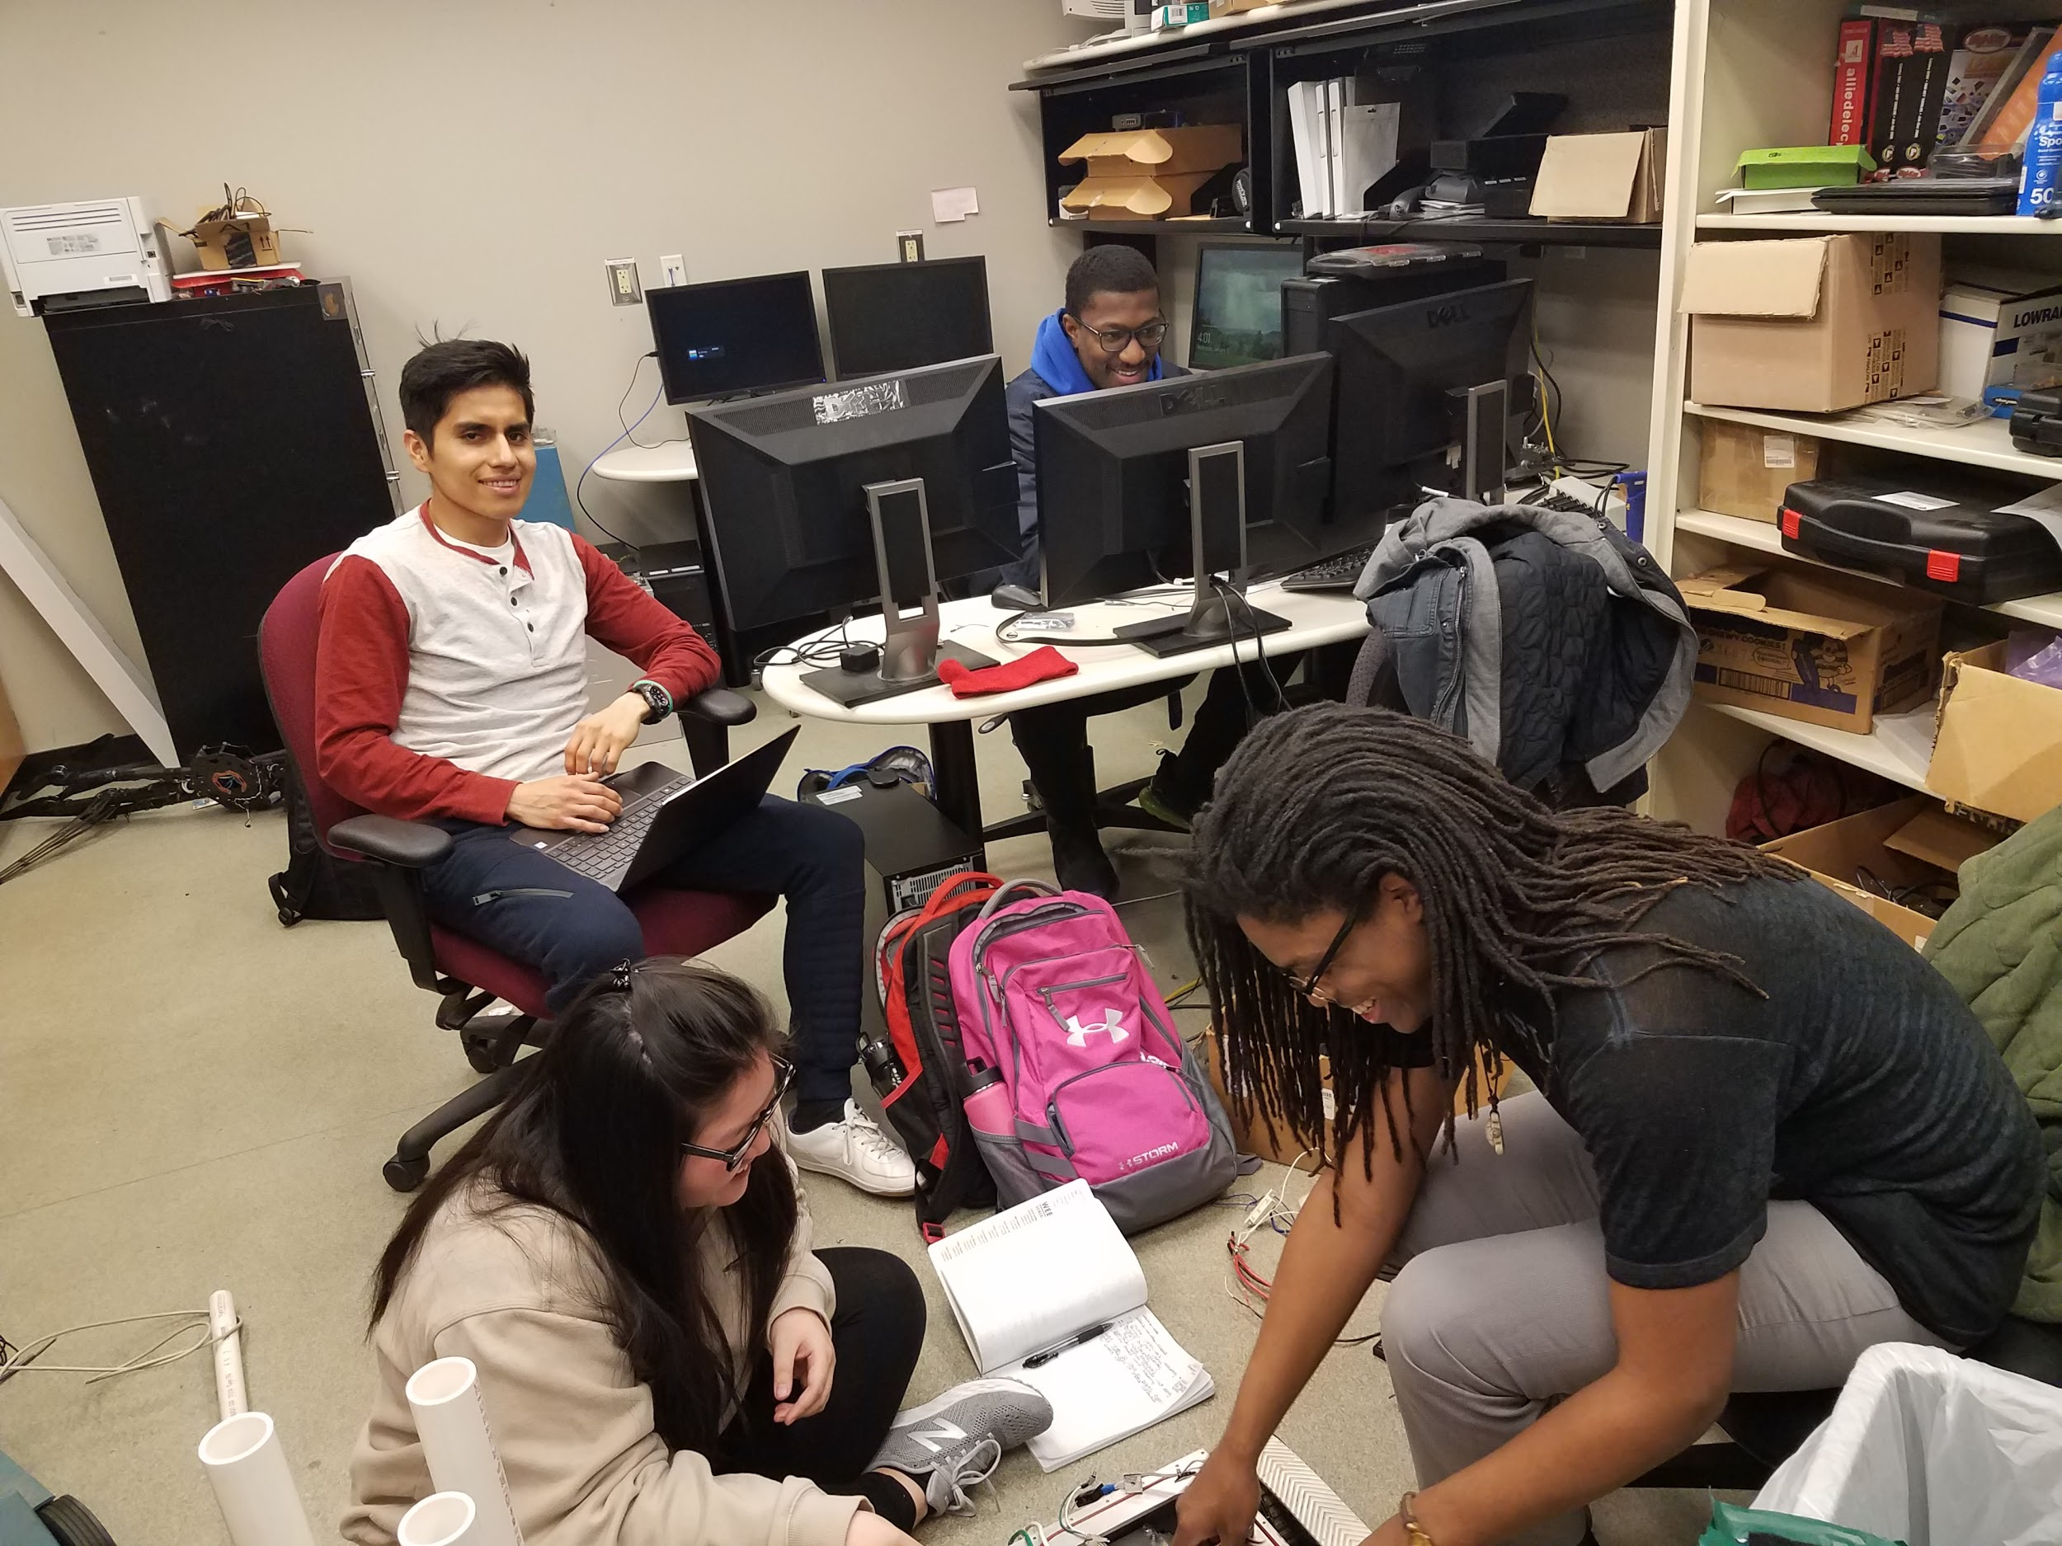
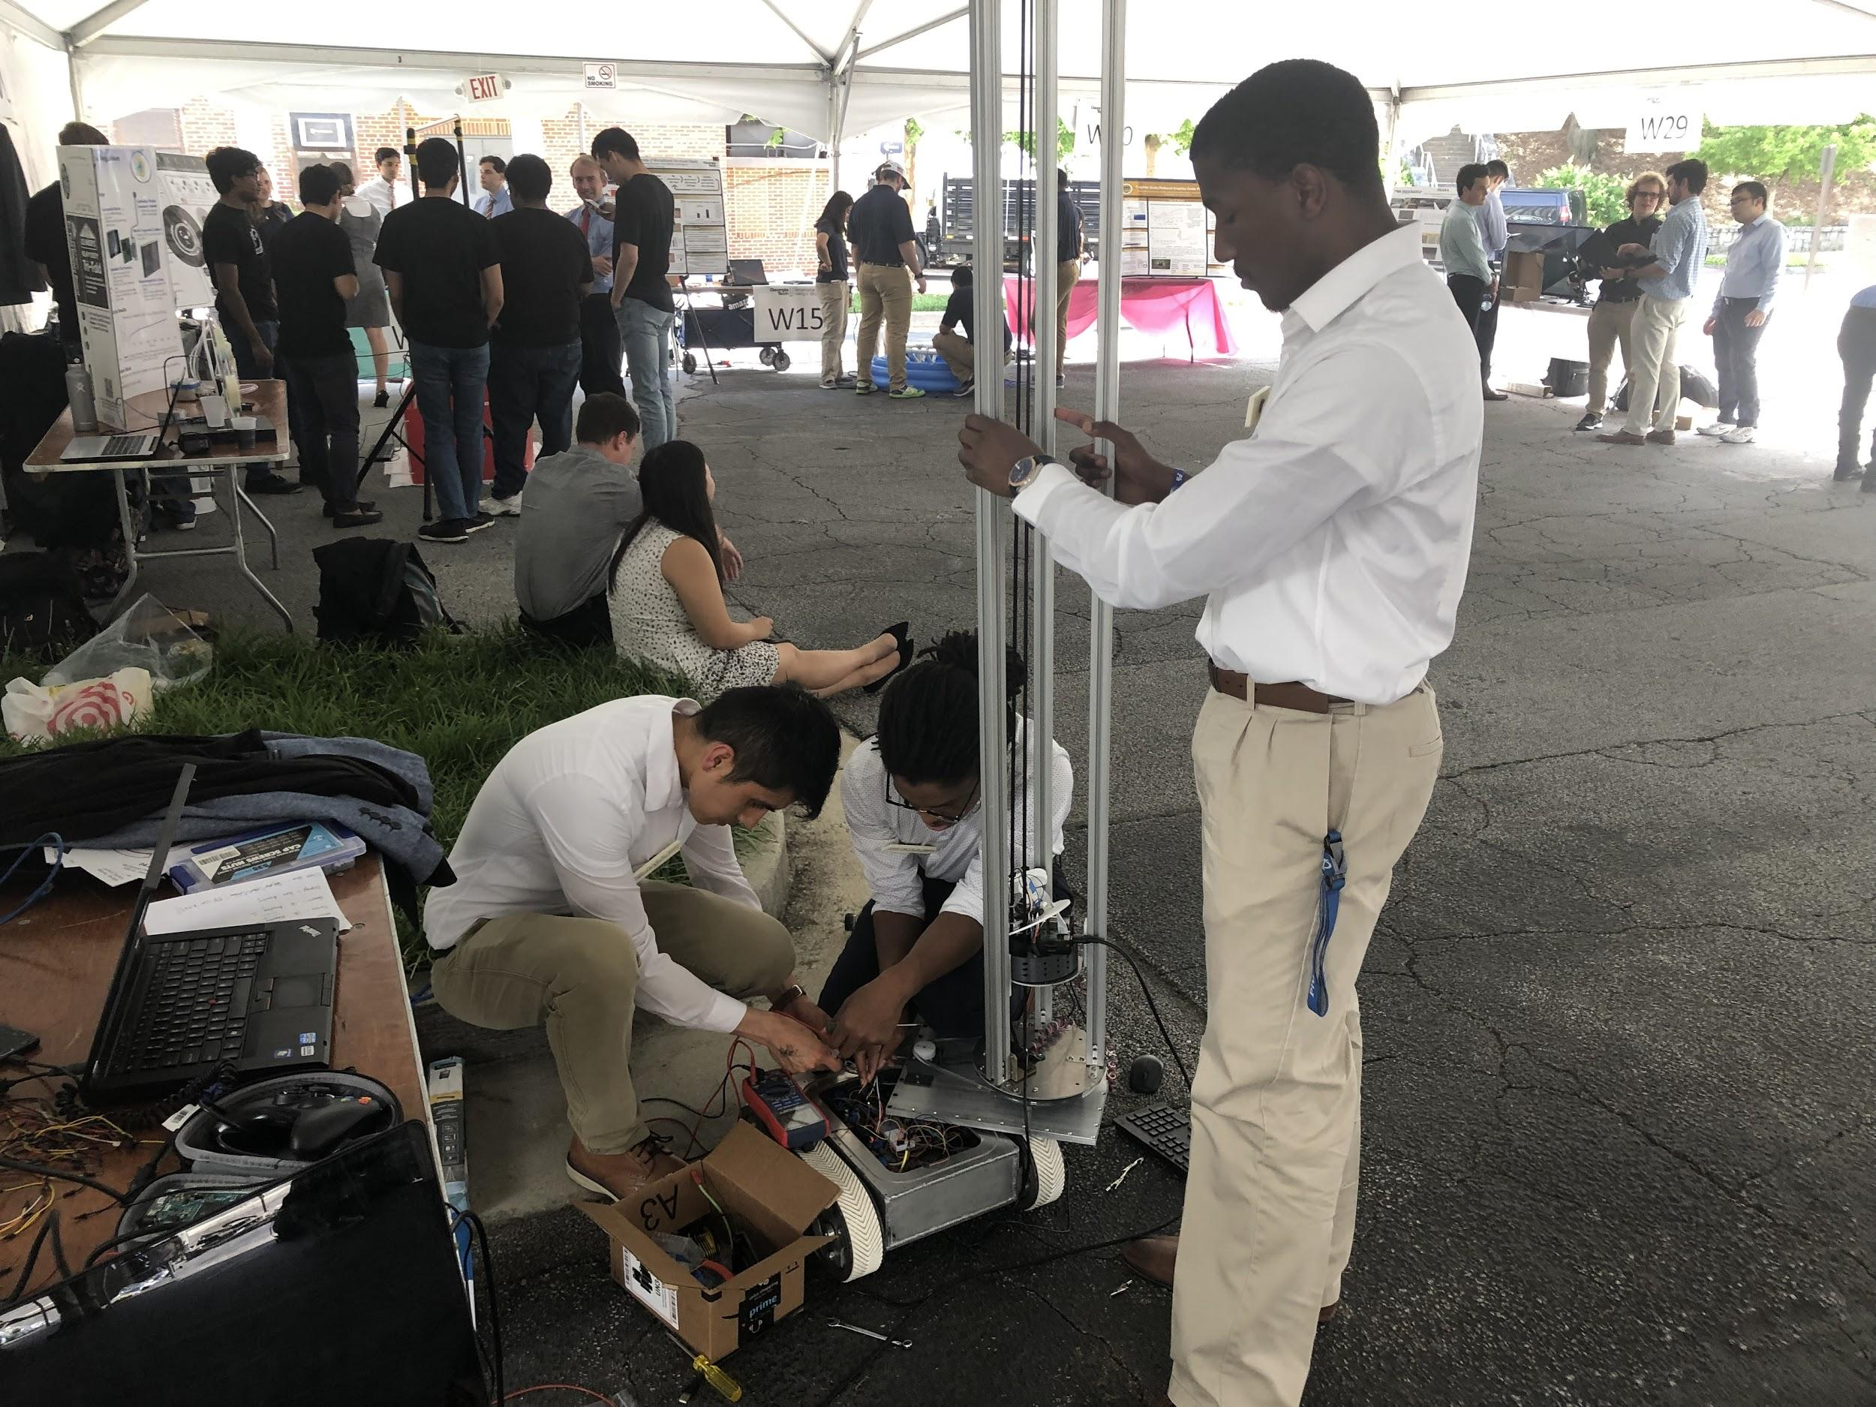
Preliminary design
Team testing
En route to Capstone
EXPO!

Slide 6
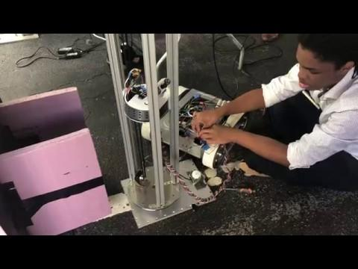
Video
Expo Troubleshooting ft. Lemek

Slide 7
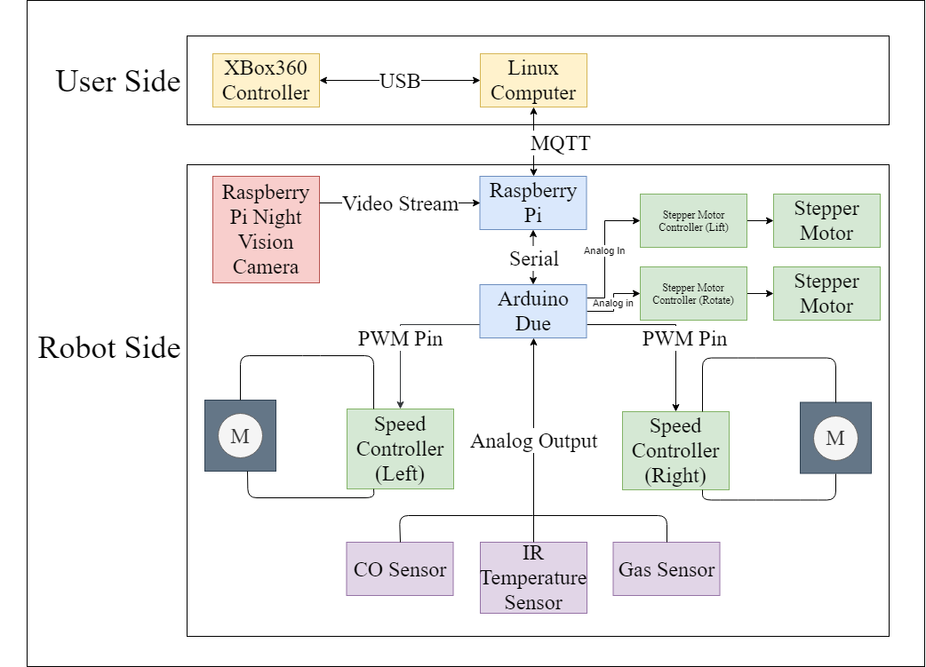
Design Overview
Design Problems:
Too many steps to get XBox inputs to the arduino
CO Sensor needs a mounting board and multiple voltages to operate

Slide 8
Mechanical Arm
Utilizes 2 Nema 17 stepper motors to lift the platform and rotate the T-slots
T-slots sit on an 8” turntable
Sensor package casing is not waterproof (3D printed)
Nema stepper motor mounts 3D printed
Sliders attached to T-slots used to enable lift of sensor package
GT2 block used to enable the rotational motion of pulley to a mechanical lift
GT2 block also used in the open belt closures for the 2GT belt.

Slide 9
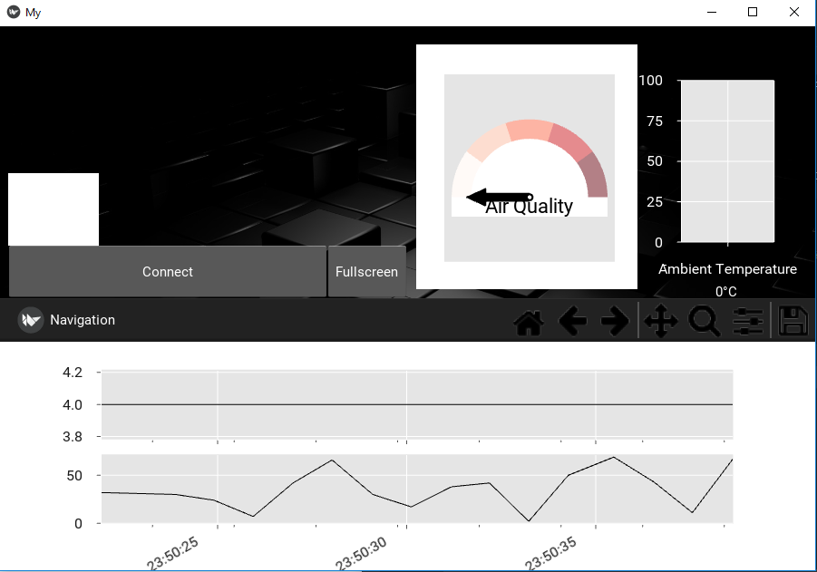
GUI
Kivy:
Task organization
Matplotlib for graphics building
Video streaming
Worked well but computationally heavy for the raspberry pi
Data collection
Subscribe to a MQTT server on the raspberry pi
Data logging option
Live audio and object temperature plot
Live gauge graphic
Live temperature bar graph

Slide 10
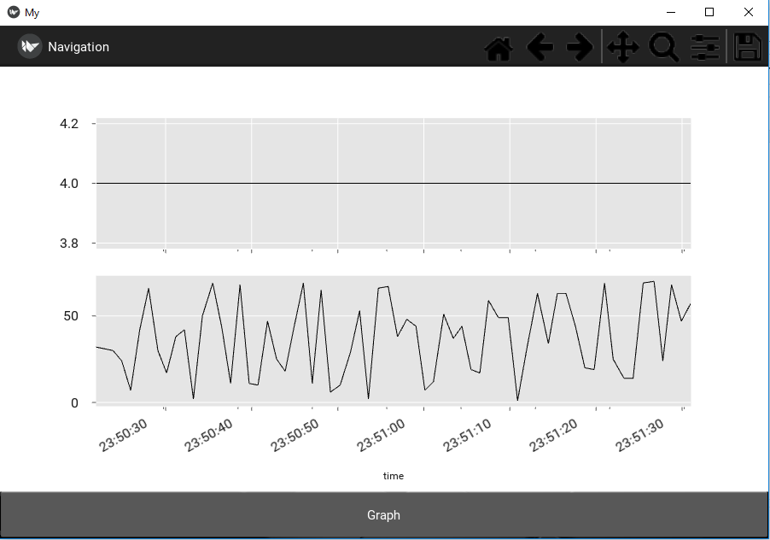
GUI
Graphing functions
Toolbar to manipulate zoom or save data to host pc
T to switch between live graph and static graph
Static data has more points and is easy to manipulate
F to toggle freeze of live graph

Slide 11
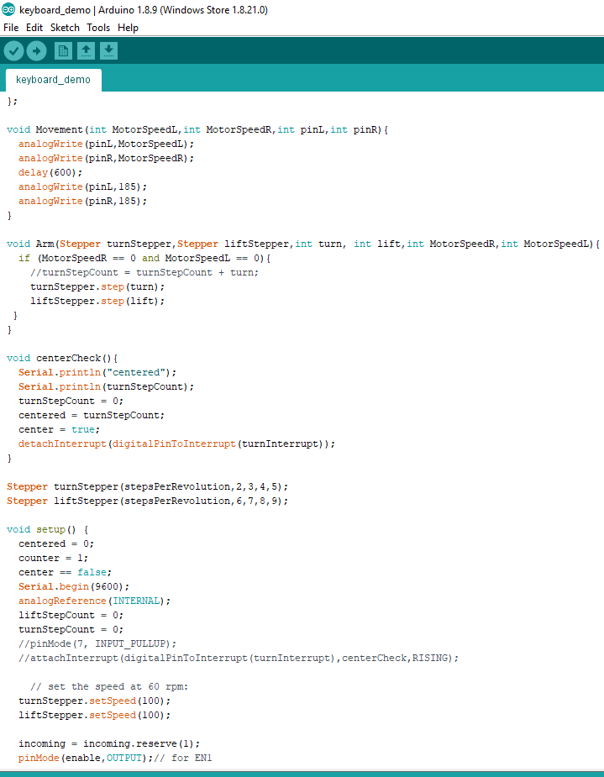
Arduino
Data acquisition from sensors
Sends motor instructions
Stepper library on digital pins for the arm motors
Pwm signal for the movement motors
Communicates to the raspberry pi via serial connection
Due analogReference minimum

Slide 12
Software Comms

Slide 13
Challenges with Hardware
Challenge: Constantly updating Bill of Materials and ordering new parts
Future Solution: Finalizing arm assembly design and schematic earlier
Challenge: Waterproofing sensor package
Future Solution: Buy waterproof box; sensors that must be exposed to the environment can have sealed openings
Challenge: CO sensor implementation
Future Solution: Buy arduino board to mount it to
Challenge: Machining
Future Solution: Waterjet holes so they are perfectly aligned the first time

Slide 14
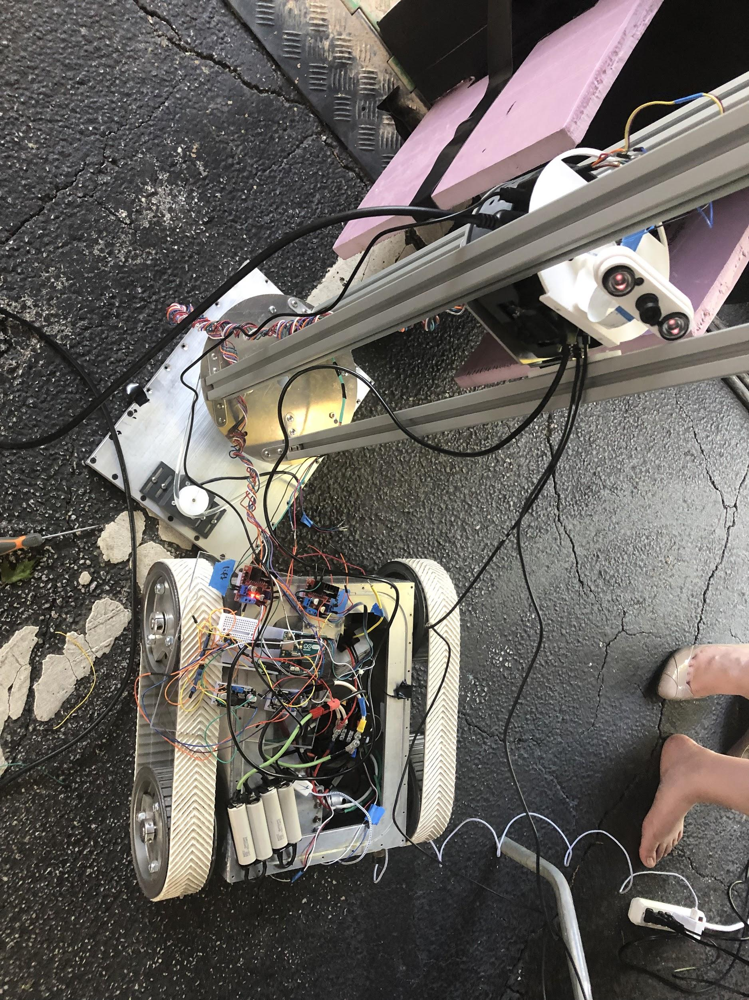
Challenges with Hardware
Challenge: Cabling and final assembly
Had a lot of parts and connections inside the robot body making it very easy for things to become disconnected
Powering everything off the same battery caused cabling to be messy
Challenge: Mechanical Arm Assembly
Conducting better research on different mechanical lift and rotational designs.
Learning how to use a CAD software for arm design
Length of T-slots made sliding for the sensor plate difficult
Pulley belts slipping when operating

Slide 15
Challenges with Software
Challenge: Serial communication to and from the Arduino is too slow to process controller commands efficiently leading to dropped inputs and a delay
Future Design Solution: Have arduino directly receive controller inputs; possibly a bluetooth module with antenna receiver
Challenge: Video stream lag
When processing mqtt code in parallel the pi could not keep up
Challenge: controller input retention
The Xbox controller only registers inputs when it refreshes and is unable to retain the last button pressed

Slide 16
BUT THE BIGGEST CHALLENGE...
Staying under budget:
Arm and Robot Lid | $511.84
Sensors and Control | $146.10
Power and Cabling | $150.37
Lab Testing and Debugging | $26.73
Demo Environment | $29.60
Total Cost | $864.64

Slide 17
Ways we could have saved money
Lab had a lot of assembly parts that we didn’t need to buy (screws, taps, wires, cables etc)
Could have gone without testing environment (usescrap wood in lab instead)
Could have used lower end power supply

Slide 18
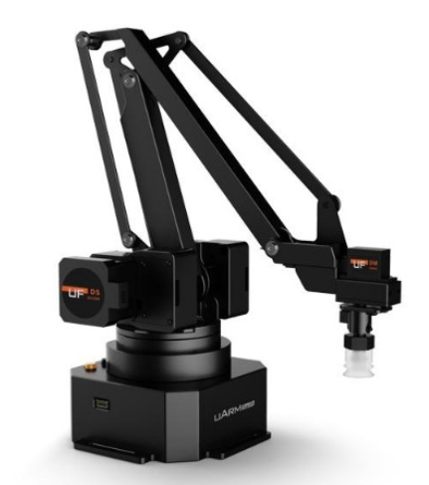
Future Improvements
Collapsible arm
Scissor lift
Implement audio capture hardware in sensor package design
GUI contains audio track already
Write training manual for utility workers
This will give everyone the ability to troubleshoot the robot
Figure Source: (Anon, 2019) [2]

Slide 19
Lessons Learned
Reduce the number of design iterations and assure at least one is complete and make changes accordingly.
Don't worry about ordering lab testing materials and check lab for assembly parts before ordering
Complete the CAD design, assembly and schematics before ordering parts
Provide more slack on cables then one might think is needed
Allow for more time to integrate software with hardware
Simplicity is best - trying to integrate too many parts results in things not working last minute

Slide 20
Works Cited
[1] Cpwr.com. (2019). Chart Book (6th edition): Fatal and Nonfatal Injuries - Fatalities from Contact with Electricity in
Construction | CPWR. [online] Available at: https://www.cpwr.com/chart-book-6th-edition-fatal-and-nonfatal-injuries
-fatalities-contact-electricity-construction-0 [Accessed 22 Apr. 2019].
[2] Anon, (2019). [online] Available at: https://www.robotshop.com/en/uarm-swift-pro-standard-4-dof-metal-robotic-arm-
bluetooth-suction-cup.html [Accessed 22 Apr. 2019].

